Slide 1
Movie Dubbing Studio Manager
Course Project for AST lecture

Slide 2
Presentation Topics
Project description
First look to User Interface
Short demonstration of the application
Project architecture
Code review

Slide 3
Project Description

Slide 4
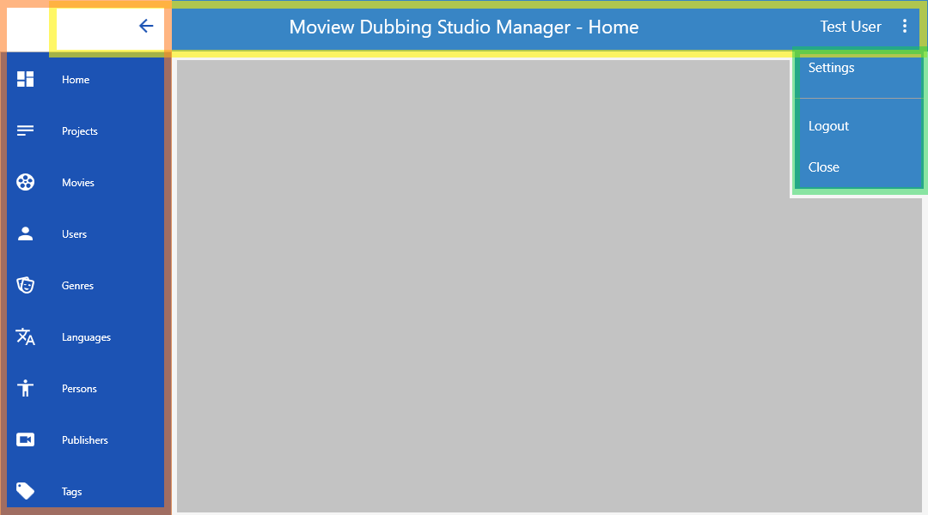

Slide 5
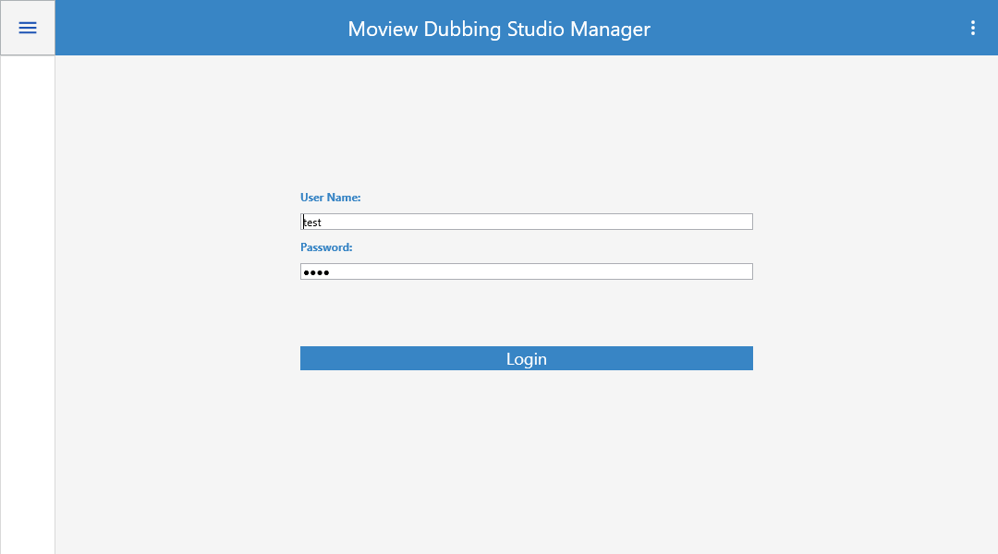

Slide 6
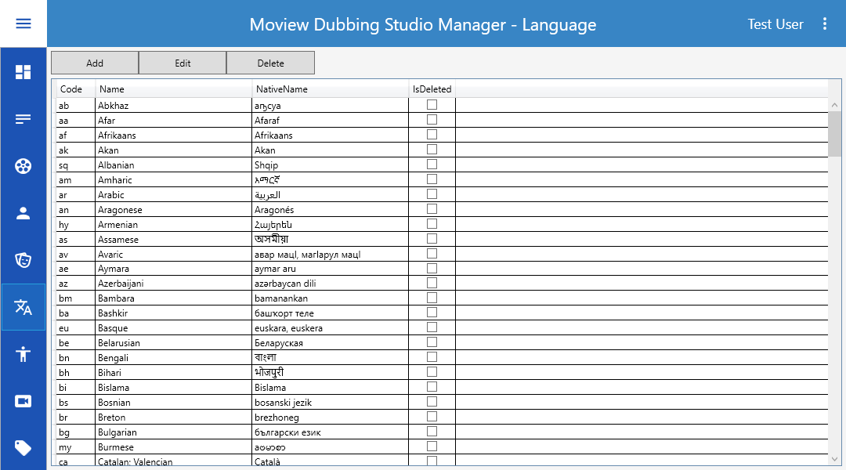

Slide 7
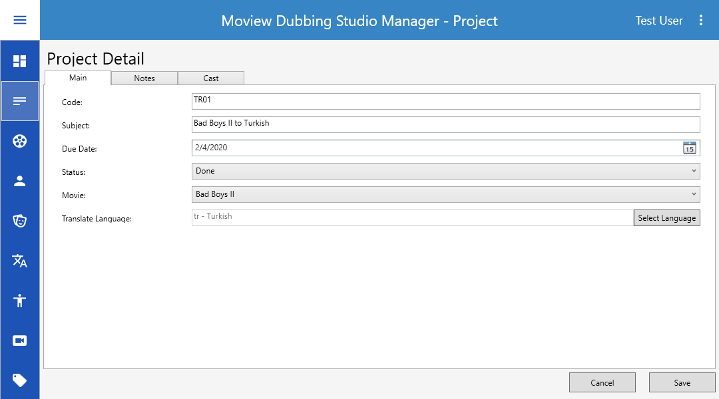

Slide 8
Demo

Slide 9

Project Architecture

Slide 10

Code Review

Slide 11

Questions

Slide 12
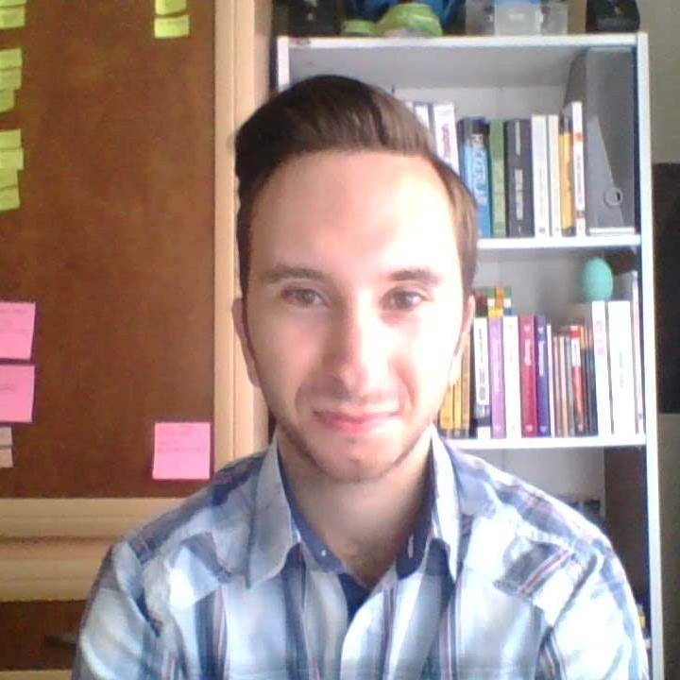
About me
Sevcan Alkan
Software Engineer 1
E-Mail sevdzhan.alkan@scalefocus.com
Github https://github.com/SevcanAlkan
Pluralsight https://app.pluralsight.com/profile/sevcan-alkan

